Slide 1
LAHORE COLLEGE FOR WOMEN UNIVERSITY
Combined events
SUMERA SATTAR
LECTURER PHYSICAL EDUCATION LCWU

Slide 2
HEPTATHLON
Athletics competition in which contestants take part in seven different track and field events in two days. The heptathlon replaced the women’s pentathlon in the Olympic Games after 1981. The women’s heptathlon consists of the 100-meter hurdles, high jump, shot put and 200 meter run on the first day; and the running long (broad) jump, javelin throw and 800-meter run on the second day. Competitors are scored for their performance in each event according to a table established by their performance in each event according to a table established by the International Association of Athletic Federations (IAAF). Jackie Joyner-Kersee, two-time U.S. Olympic gold-medal winner, was the most-notable heptathlete. A less-common men’s version of the heptathlon takes place indoors and replaces the hurdles, javelin throw and runs with the 60-meter hurdles, pole vault and 60 and 100 meter runs.

Slide 3
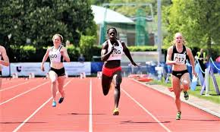
History:
Women first completed in the pentathlon – five disciplines – at the 1964 Olympic Games in Tokyo. This format was later replaced by the heptathlon, with the addition of the javelin and 800m. The enlarged event was first contested at the 1983 IAAF World Championships and then the Olympics Games in Los Angeles.

Slide 4
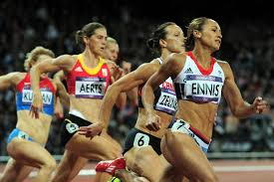
Heptathlon at the Olympics:
Heptathlon is the seven – event track and field race conducted exclusively for women in the Olympics as an equivalent for the men’s decathlon. Heptathlon was included into the games for the first time at the 1984 Los Angeles Olympics. The first men’s events came at the 1904 Summer Olympics a triathlon had long jump, shot put and 100 yard dash events, while an all-around championship saw athletes compete over ten events,

Slide 5
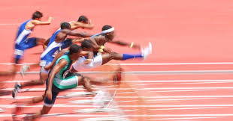
forming the basis for the decathlon. No combined events were held at the subsequent games, but the 1912 Summer Olympics saw the introduction of the modern decathlon event and also a men’s pentathlon (which lasted for three games). The first women’s event came in 1964 in the form of the women’s pentathlon. This was amended to include two more events, becoming the heptathlon at the 1984 Summer Olympics, reflecting the development of women’s sport. The Olympic record in the decathlon is 8893 points, set by Czech athlete Roman Sebrle in 2004. Jackie Joyner-Kersee’s score of 7291 points to win 1988 is both the current Olympic and world record for the heptathlon – this remains the only occasion that record has been broken at the Olympics .
SKILLS:

Slide 6
Professional sports athletes need to have a competitive mindset, excellent hand-eye coordination, great motor skills and a high level of physical fitness.
Taking a part in sports is important for children as it reduces stress and enhances their mood. It builds healthy bones and muscles, increases fitness, improve sleep, helps them socialize, improves their cooperation skills, boosts self confidence and lowers the risk of getting obese. Sports, whether team-based or individual are a great activity for children that provide a variety of benefits other than physical activity. Participation in sports can help build self-esteem and confidence, can motivate children to excel academically and can help build social skills.
GAMES IN HEPTATHLON:
The women’s outdoor heptathlon consists of the following events, with the first four contested on the first day and the remaining three on day two:

Slide 7
100 meters hundels
High jump
Shot put
200 meters
Javelin throw
800 meters
7. Long jump
This is the women’s ultimate all-round test, a seven-event contest covering the whole range of athletics discipline and spread over two days.
Competitors earn points for their performance in each discipline and the overall winner is the athlete who accures the most points.
The first day consists of (in order): 100m hurdles, high jump, shot put and 220m. Day two comprises the long jump, javelin and 800m.

Slide 8
DAY 1
100m hurdles
High Jump
Shot put
200m race
DAY 2
Long Jump
Javelin
800m race

Slide 9
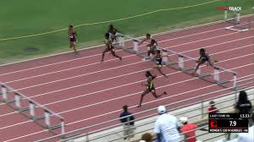
100 METERS HURDLES:
This event measures basic leg speed and each race/heat will have between 3 and 8 runners. You will push off a set of starting blocks at the start as a reaction to a starters pistol, sprint for 100 meters and lean at the finish line. The race can be timed with a hand held stopwatch to the tenth of a second or by an automatic timing device which will catch the runners in 1/100ths of a second. The hurdle race are sprint races in which competitors must overcome a number of barriers wood and metal.

Slide 10
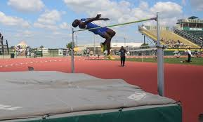
HIGH JUMP:
Yet another explosive event where the athlete must approach the bar and landing area, gather himself and leap (always off one foot) over a crossbar. The landing pit is usually made of foam rubber. The crossbar is raised, usually 3cm (@ 1 1/4inches) and an athlete is eliminated after three consecutive misses. The highest height cleared is used for scoring.

Slide 11
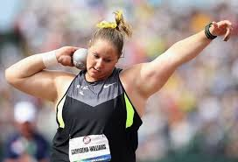
SHOT PUT:
The shot put measures basic arm strength. Again, three tries counting only the best effort for scoring. The athlete attempts to push or “put” (not throw) a 16-pound iron ball so that it lands within a sector of 40 degrees. The throwing circle is seven feet wide and made of concrete. Efforts do not count if the athlete oversteps the throwing circle or if the shot lands outside of the sector lines. Shot put, sport in athletics (track and field) in which a spherical weight is thrown or put from the shoulder for distance.

Slide 12
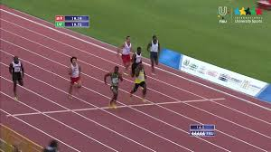
200 METERS:
The 200 meters is a sprint running event. On an outdoor race 400m track, the race begins on the curve and ends on the home straight, so a combination of techniques are needed to successfully run the race. A slightly shorter race, called the stadion and run on a straight track, was the first recorded event at the ancient Olympic Games. The 200m places more emphasis on speed endurance than shorter sprint distances as athletes predominantly rely on anaerobic energy system during the 200m sprint.

Slide 13
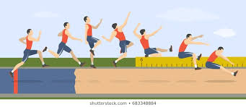
LONG JUMP:
The athlete runs toward the landing area, plants his takeoff foot on an 8 inch ‘toeboard’ and leaps into a sand filled pit. The distance is measured from the mark made in the plit which is closest to takeoff board. Speed and accuracy are secondary to leaping ability. Each athlete will have only 3 chances and only the best jump will count in the scoring.

Slide 14
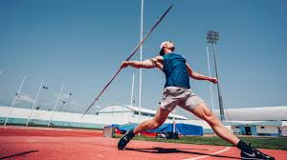
JAVELIN:
The javelin is metal spear approximately 8 feet in length and weighing 800 grams. It must be held by a grip and the throw made behind an arc. At all levels except the high school the javelin must land point first within the sector which is 29 degrees wide. Each athlete is given three attempts and the best throw is scored.

Slide 15
“JAVELIN THROW – RULES”
. Holding the javelin must be done at the grip part and should always be maintained above the shoulder level.
. For valid throw, the javelin must lie before the specified zone and its tip should hit the ground.
. There is special marking line on the runway within which the athlete needs to throw.
. After beginning your throw, you may not touch any boundary line of the runway. Touching outside the lines results in a foul. If the javelin drops during the course of your throw, it is a foul however the tail of the javelin may hit the ground during the throw with no penalty.

Slide 16
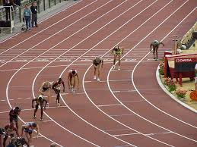
800m Race:
The 800 meter dash and 800 meter dash is a test of the current middle distance athletics in which each athlete runs for their respective road for the first 100 meters passing from that point to the so called “free road” normally consists of the lanes 1 and 2 of the track.

Slide 17
Middle Distance 800m 1500:
. The athletes in the 800m run the first curve in separate lanes and break after 100m to avoid crowding.
. It’s an advantage for an athlete to be drawn in one of the outer lanes as they can choose which position they want to take in the field.
Run your 800m:
. Start of the race off right. Run fast at a speed that you can maintain well.
. Be smart in the middle of the race.
. In the last 200m or 300m, begin to sprint at full pace.
. Be conscious of when you are over exerting yourself so that you have enough energy for the second acceleration at the end of the race.

Slide 18
800 meter Run Test
Rating Time
(minutes/seconds)
Average 3’16” – 3’30”
Above Average 3’01” – 3’15”
Good 2’46” – 3’
Excellent 2’45” or less

Slide 19
“SCORES”
In each, the athlete scores points for his/her performance in each event according to scoring tables issued by the International Association of Athletics Federations (IAAF). The athlete accumulating the highest number of points wins the competition.
How is it scored?
The basic premise is that a high-level performance in each event should score a competitor approximately 1,000 points.
There’s room to exceed that standard and room to fall short.

Slide 20
There are three different equations to create the scores for each event in the heptathlon. For running events, it’s the
P = a . ( b – T )^{c}
Seen above, where P is the number of points scored, T is the competitor’s time and a , b and c are Ulbrich’s specially derived coefficients. These coefficients change for each event:
Event | a | b | c
200m | 4.99087 | 42.5 | 1.81
800m | 0.11193 | 254 | 1.88
100m hurdles | 9.23076 | 26.7 | 1.835
High jump | 1.84523 | 75 | 1.348
Shot put | 0.188807 | 210 | 1.41
Long jump | 56.0211 | 1.5 | 1.05
Javelin throw | 15.9803 | 3.8 | 1.04

Slide 21
HISTORY OF PENTATHLON:
The first documented pentathlon occured in 708BC in Ancient Greece at the ANCIENT OLYMPIC GAMES.and was also held at the other Pan- HellEnic GameS.the name drive from GREEK Word for “five compitions “The event proved popular and lent itself to illustration for pottery.It also featured in GREEK Mythology the mytical hero Perseus
Full filled and oracle Prophechy by accidentally Killing Acrisius with Dis-cus while competing of a pentathlon.1912 olympic gold medal Winner
FERDNAND Bie.
The modern pentathlon Was introduce by Baron de coubertin at the
Stockholm Games in 1912 comprising Pistal shooting, Fencing, swim-ming ,horse riding and running.Pentathlon moment came two years later at the session of international Olympic committe In Budapest.

Slide 22
Olympic History of Pentathlon
From 1912 to 1980 the olympic Modern pentathlon Competions was held over five days With one event per day.Between 1984 and 1992,
the competions was held four days with either running or shooting, swimming,Shooting on the same day.For the atlanta OLYMPIC GAMES 1996 The competions was a one day event In which 32 men Who qual-ified via Pre – olympic competions Participated In 1998 the UIPM reci-eved approval women compete In SYDNEY 2000 Olympic games So 24 men and 24 women Competed in individual competions. And for the first time in history The pentathlon venues Were 96% sold out.UIPM is subsequent recieved and increase in the quota in Athens 2004, 32 men
32 women compete Both competions were 100% sold out.

Slide 23
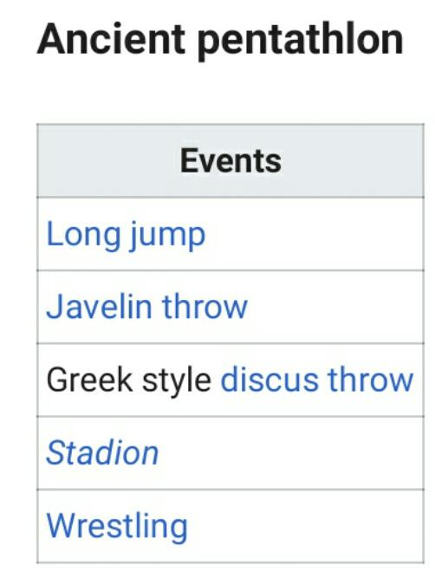
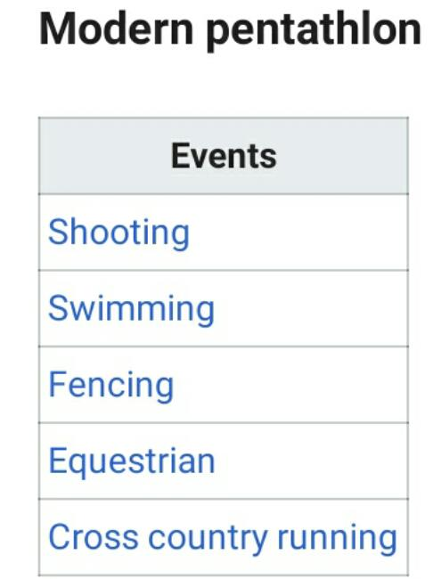
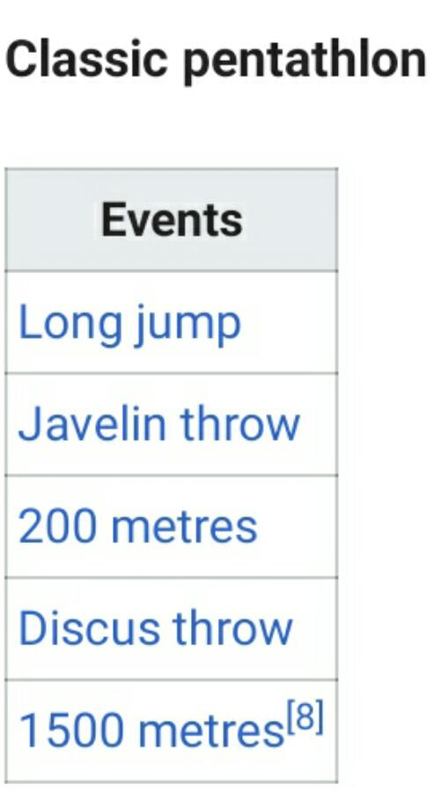
STYLES OF PENTATHLON

Slide 24
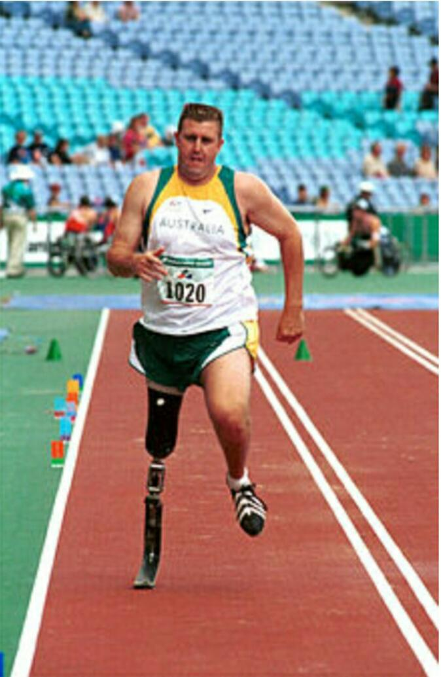
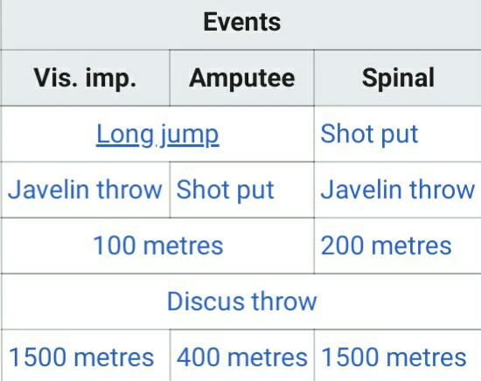
PARAlYMPIC PENTATHLON:

Slide 25
PARTICIPATING COUNTRIES
Even through being added Long back in 1912 and still being a part of
Olympic games Modern pentathlon has its own share Of uos and downs .Throughout the whole phase changes have been made To the sport at the same time Countries started payin intrest in this sport.Pre-
Sently around 28 countries are part of this sport.
Some of the countries have shown that more intrest And have achiev-ed numerious medals In the participate sport SWEDEN, USA,CZECH,-
REPUBLIC, RUSSIA,Lithuania,Poland, Italy,Germany,Britian.

Slide 26
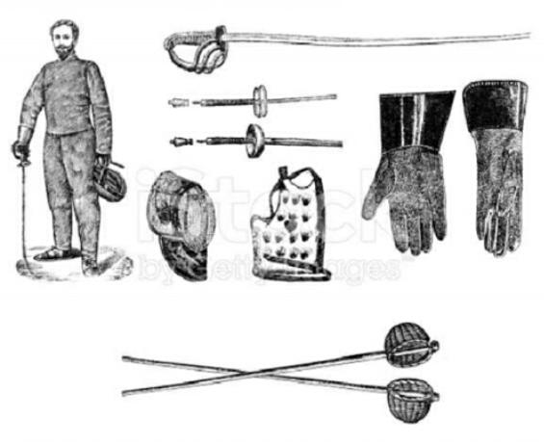
MODERN PENTATHLON EQUIPMENTS
EQUIPMENT FOR FENCING:
The equipment used in fencing are two
Category Namely protective
Clothing, weapons.PROTECTIVE CLOTHING:
The protective clothing
that are used in fencing gloves, jackets
,sous-plastron,Mask,knickers,
Chest protector,sleeve,Most protective
equipments is used in fenicg
Made up of tough cotton,Nylon Kevlar is
used For making jackets.
Breeches underarm protector.

Slide 27
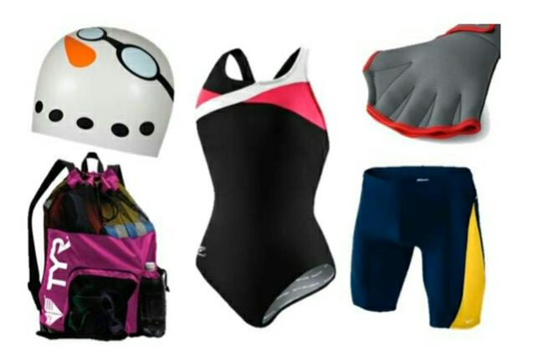
EQUIPMENTS FOR SWIMMING
The 200m freestyle Swimming equipments include google swimming
And a cap swimming trunk,The swimming goggle is used To protect eyes and for clear visbility inside water and help the swimmer to swim
Comfortabely underwater.Swimming cap is used to avoid hair coming on face While swimming Which can be very Annoying While swimming.

Slide 28
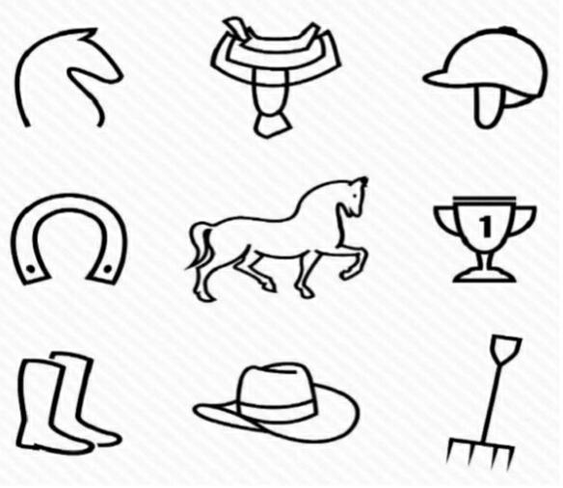
EQUIPMENTS FOR SHOW JUMP
Show jump is done With the help of horse In which a rider sites on a horse and perform the show jumping. It is one of the most exciting event to watch out for .In this sport many jumps are performed hence its requires Many types of equipments for the rider to control the horse,HORSE TACK,Stirrups,
Halters,Reins,Bit, Breastplates,Martingale.

Slide 29
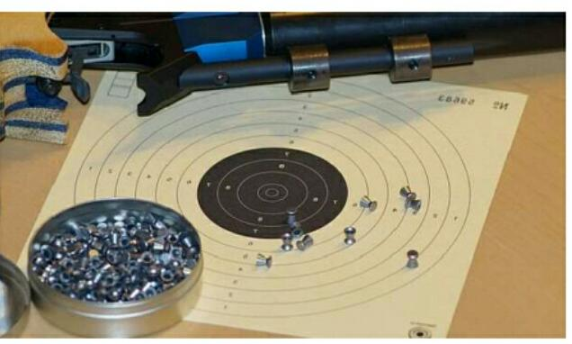
EQUIPMENTS FOR PISTOL SHOOTING
Earlies player were asked to choose a pistol Of their choice their shooting Sports . These pistol were single shot pistol re-volvers semi-
Automatic pistol and machine pistol ,presently in case of combined
Event laser pistol has replaced the traditional .These pistols shooting
event faster than before.

Slide 30
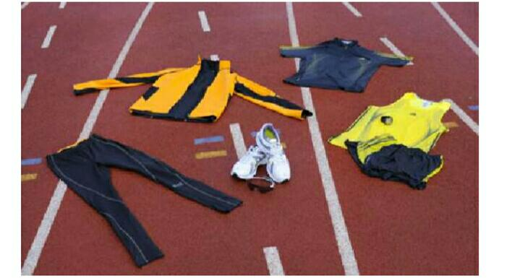
EQUIPMEMTS FOR CROS COUNTRY RUN
Cross country has very little specialized equipments .Most race are performed in shorts vest and shoes.The most common footwear is
Used in cross country Spikes.This are light weight shoes.

Slide 31
RULES AND REGULATIONS PENTATHLON
RULES FOR FENCING:
In case of fencing the player cannot posses an epee having a curve more than 1 cm.Any touch after the command
Allez Or before Halte of the sport is valid wheares the players can’t stop In the middles of the sport to ask about the remaining time which may result in penalty.
RULES FOR SWIMMING :
In case of swimming the end walls at both sides of the swimming pool
have to be touch in order to make a valid turn.some parts of the swimmer must be above water at any time during the race expects the first 15m.The player neither enter nor leave the swimming pool with-out the referee Prior permission .

Slide 32
RULES FOR THE SHOW JUMP:
In case of show jump,the player must follow the proper dress code.The player
Cannot jump an obstacle before the round start or the ring bells.The player will
be eliminated If the horse moves in either wrong direction of Out of the competions court .
RULES OF SHOOTING AND CROSS COUNTRY RUNNING:
In case of combined event the player must finish the race in order to stay In the sport .The player mustnt modify his starting number as this will result be disqualified from the event .
The player cannot Start running again before minimum shooting time is over.
The player cannot obstruck Other player during the run Which may result in disqualification From the sport.The player cannot exchange their pistolS during the game .

Slide 33
CHAMPIONS PENTATHLON

Slide 34
SCORING:
Scoring for the modern pentathlon Is different for each event .
Athletics earn point in the fencing,Swimming, horse riding event,
And the higher they score the greater “head Start” They will be
given for the combined event at the end.From that point on-
Wards the winner is simply the athlete cross the finish line first.
Pentathlon scored is discipline On a 1000 point scale.For the
swimming ,running event.

